Slide 1


Discovering the Network Backbone from Traffic Activity Data
Kiran Garimella, Sanjay Chawla, Aristides Gionis, Dominic Tsang
Notes:
This is joint work between Aalto University and University of Sydney
Sanjay is on leave from Sydney at Qatar computing research institute

Slide 2
Problem
Simplifying networks
Identifying the backbone of networks
Graph/network sparsification
Notes:
The main problem we are trying to address in this paper is to simplify networks
This is generally known as network sparsification in the literature
We call it identifying the backbone of the network because of reasons I will explain in the further slides

Slide 3
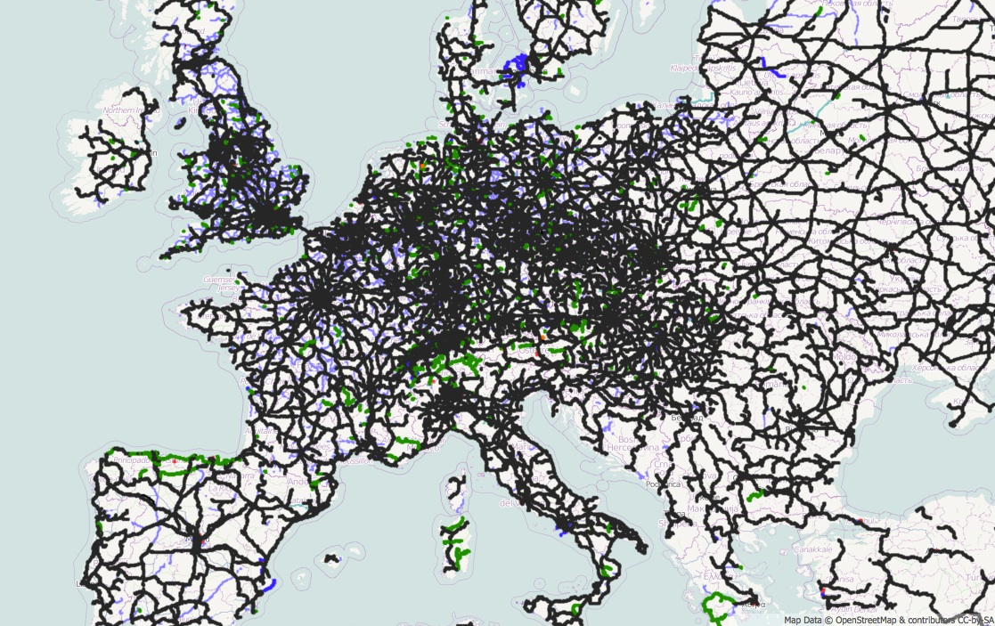
Networks are complex
Notes:
Real world networks are large and complex. Some times we might need to simplify the complexity of these networks to get an overview of the most important aspects of the network.
Shown here is an image of the road network in europe. It is very hard to understand a lot from such a map

Slide 4
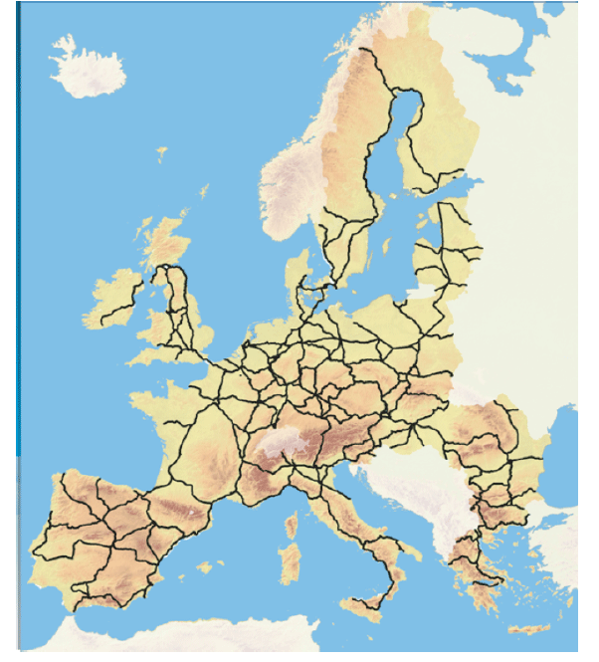
Backbone - Simplifying networks
Notes:
What we propose in this paper could be used to summarize the previous map into something easier to understand like this. (this is just an illustrative example. Not an output of our algorithm). Such a representation helps understand the ‘important’ portions of the network.
Such a simplification has a lot of applications that have been studied in the past, including for example, where can I place sensors to monitor a set of resources to prevent critical failure in the network

Slide 5
Drawback of existing work
Real world networks
Structural
How the network is organized
Functional
How the network is used in real world
Notes:
So based on these examples, as I had mentioned, previous research has looked into network sparsification, but one key aspect has been missing in the related work
Real world networks have two main aspects – structural and functional. Strtuctural aspects capture how the network is organized in terms of shape. This aspect of network structure has generally been the main focus of study in the area of network sparsification/simplification.
But recently with the explosion of digitization, there has been a plethora of information about the functional aspects of a network. That is, how the network is being used in the real world. Let me give an example to illustrate

Slide 6
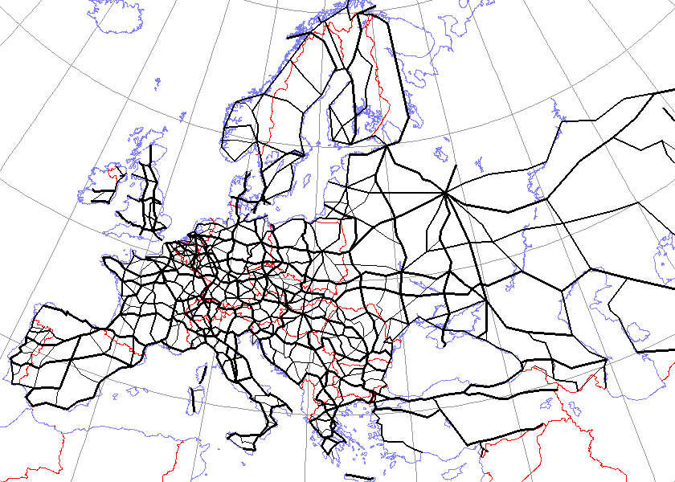
Example (Structural aspects)
Notes:
As I sad, this is an example of the structural aspect of a network, just a network of roads in europe.

Slide 7
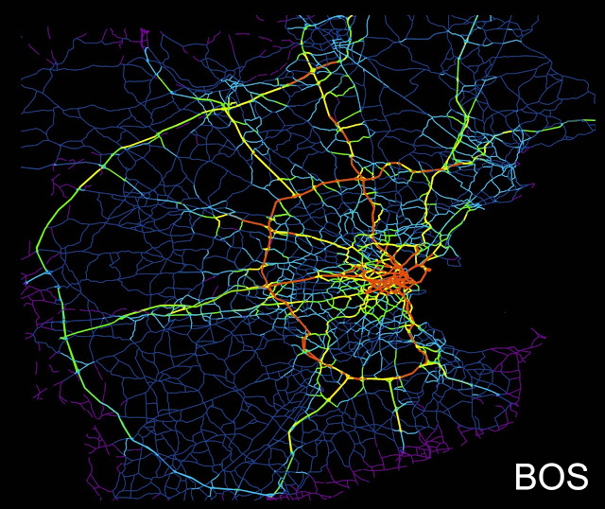
Example (Functional aspects)
http://www.nature.com/articles/srep01001
Notes:
But this figure, for example shows the functional aspect. That is how the network is being used. This is a map of the road network of boston. The colors indicate the amount of traffic that flows on the road. Darker orange indicates higher traffic and blue indicates lesser traffic. We can observe that though the road network is huge, only a very small portion of it is being used most of the time by the users. This is a very important aspect of networks that has been missing in the analysis and network simplification literature.

Slide 8
Motivation
Existing studies mainly focus on structural properties
Wealth of functional information available (e.g. GPS traces)
Notes:
Also, this functional information has become more and more easier to collect now a days with the ubiquity of mobile phones. For example, we can easily obtain gps traces of a trip of the users of a city.

Slide 9
In this paper
Combine both structural and functional information to summarize a network
Notes:
In this paper, we present a first approach to incorporate both structrual and functional information of the network to summarize/simplify a network

Slide 10
Example
Weighted graph G(V,E)
8
B
F
1
2
A
4
3
H
3
4
1
3
G
C
D
E
3
2
Notes:
Let me start with an example to introduce the terminology. We are given a weighted graph G, like the one shown here. lets say for example, this graph represents a road network. The edges represent roads, nodes represent junctions. The weights on the edges represent the distances between places.

Slide 11
Example
Traffic/Activity log L (s,t,w)
8
(A,G,10)
(B,E,12)
(C,G,21)
(A,H,5)
….
….
….
B
F
1
2
A
4
3
H
3
4
1
3
G
C
D
E
3
2
Notes:
The network/graph shown previously captures the structural aspects. Now lets define terminology to capture the functional aspect. Here we use the concept of a traffic or activity log., which is a set of triplets, (start vertex, end vertex, activity) .. The box on the right shows an example of a traffic log. For example, here it says that there was an activity of 10 points between vertices A and G, …
Note that the activity (w) here is different from the weight of the edge and they capture two different things. For example in the road network, the weight captures the distance between nodes and the activity captures how many cars have started from a node and ended at the other node. This latter part encodes the functional information

Slide 12
BackboneDiscovery Problem
Given a weighted network G(V,E)
A traffic log L = {(s_{i},t_{i},w_{i})}, |L| = k
A budget B
Find a set of edges R of total cost B that minimizes the stretch factor S(R)
Output: Backbone of the network G(V,R)
Notes:
Now we are ready to define our Backbone discovery problem. We are given a network G and a traffic log, represented as triples. We are also given a budget B. The objective is to find a subset of edges that minimizes the objective function (which we call stretch factor). I’ll define what the stretch factor means in a moment. The output of our problem is a sparse network which has lesser edges, which can best capture both the structural and functional information in the network.

Slide 13
BackboneDiscovery problem is NP-hard
Proof: Reduction from the SET COVER problem.
Notes:
Firstly, we remark that the backbone discovery problem defined above is NP hard. Please refer to the proof in the paper.

Slide 14
Objective function - Stretch factor
Intuition 1: How longer are the shortest paths using the backbone edges R instead of E
Intuition 2: Capture both shortest paths and activity
Notes:
Now I’ll define what the objective function is and how we encode both the structural and functional information. Our objective function is based on two ideas: 1. We should be able to capture how well we can preserve the shortest paths in the original graph, but at the same time also take the activity on the network into account.
This objective function, is inspired from the classic problem of spanner graphs, but modified a bit to fit our case.

Slide 15
Stretch factor
Defined as harmonic mean, to account for missing edges
For
Notes:
The stretch factor is defined as the weighted harmonic mean of the shortest path distances in the sparse graph. I will not go into details, please refer to the paper for details. The reason for defining it as harmonic mean is that it naturally handles missing edges, which might cause infinite distances.

Slide 16
Stretch factor
Defined as harmonic mean, to account for missing edges
For
Shortest path between s_{i},t_{i}
Notes:
The w in this equation is the activity and the d(s,t) is the shortest path distance

Slide 17
Algorithm
Greedy algorithm
Idea: Capture both structural and functional information
Functional
In each step, pick the (s,t) pair in the log, such that the stretch factor is minimized
Structural:
Make sure that edges which occur in many shortest paths are preferred
Can be captured using edge betweenness centrality
Notes:
Now let me give you a sketch of the algorithm.
Our main algorithm works greedily, which makes sure we capture both functional and structural information.
In each iteration, the algorithm greedily picks the best (s,t) pair from the log that minimizes the stretch factor. We also make sure that the s,t pairs that are selected also include as many shortest paths as possible, to capture the structure. This is ensured by weighting the edges considered by a benefit function, defined using the edge betweenness centrality.
A quick note on edge betweenness: Edge betweenness captures the number of shortest paths that go through an edge. So if an edge has a lot of shortest paths passing through it, it has a high edge betweenness
The algorithm is a bit more complicated, I will not go into the fine details. Please refer to the paper for the details.
Though our algorithm makes use of shortest paths, in practice, any other types of paths could be incorporated into our algorithm (e.g. random walks).

Slide 18
Algorithm runtime
Requires k² shortest path computations
Notes:
The algorithm proposed above computes the shortest path k2 times and has a complexity shown here. Here I is the number of iterations, and it is dependent on the budget of the algorithm. Next we propose optimizations to make this algorithm run faster

Slide 19
Algorithm runtime
Bottleneck
Notes:
If we look at the algorithm, the main bottleneck is in the step computing the shortest paths. If we can intelligently reduce the number of times this function is computed, we can make the algorithm faster.

Slide 20
Optimizations
Optimization 1: Maintain a list of connected components and compute the shortest paths only if the current component is affected by the edge addition.
Notes:
I’ll briefly go through the optimizations we made.
The first optimization is based on the way we construct the backbone. Initially we have individual nodes and as the algorithm picks edges greedily, we add them to the backbone graph. During this process, we can keep track of the connected components that we already have so that we can only update the shortest path ønly if the current edge is across different connected components, because we can re-use previously computed shortest paths if the new edge belongs to the same component

Slide 21
Optimizations
Optimization 1: Maintain a list of connected components and compute the shortest paths only if the current component is affected by the edge addition.
Optimization 2: Maintain an optimistic lower bound on the shortest path.
Notes:
The next optimization we perform is: for pairs for which we have to recompute a shortest-path dis- tance, we first compute an optimistic lower bound, based on the shortest path on the whole network (which we compute once in a preprocessing step). If this opti- mistic lower bound is not better than the current best stretch factor then we can skip the computation of the shortest path on the backbone.
In practice, these two optimizations lead to 20-35% improvement in performance.

Slide 22
Optimizations
Optimization 1: Maintain a list of connected components and compute the shortest paths only if the current component is affected by the edge addition.
Optimization 2: Maintain an optimistic lower bound on the shortest path.
Optimization 3: Use landmarks for approximating shortest paths.
Notes:
The final and most effective optimization we do is the use of landmarks to reduce the run time. Landmark based shortest path approximation is a well known method in literature and studies have shown that even for very large graphs, only a few dozen well placed landmarks can be used to approximate the shortest path distances to a good quality.

Slide 23
Optimizations
Optimization 1: Maintain a list of connected components and compute the shortest paths only if the current component is affected by the edge addition.
Optimization 2: Maintain an optimistic lower bound on the shortest path.
Optimization 3: Use landmarks for approximating shortest paths.
Using the optimizations, we get down the running time to:
Notes:
With these three optimizations, we can reduce the k2 multiplicative term and reduce the runtime a lot. In the above equation, l is the number of landmarks, which is typically very small compared to n.

Slide 24
Experiments
Performance comparison with a baseline
Speed up achieved by the optimizations
Skipped
Stretch factor behavior
Comparison with related work
Notes:
Now I’ll briefly go through some of the experiments we did. I will not go through all experiments, please refer to the paper for more.
I’ll first talk about the performance of our algorithm when compared to an effective baseline and the speed up achieved by the optimizations I mentioned.
We also compared our algorithm with other existing approaches in literature and show the effectiveness of our approach. Please refer to the paper for the details.

Slide 25
Experiments
Notes:
But firstly I want to point to the datasets we use in the experiments. We use 5 real world datasets of various sizes, densities, and representative of typical road networks to show how our method works.

Slide 26
Comparison to a baseline
Notes:
First experiment is a comparison with a baseline: edges are added to the backbone one by one, in decreasing order of their effective distances. We tried out various other baselines, but this is the one that worked the best.
The y axis is our objective function that we want to minimize and the x-axis is the % of edges added. So we compute the stretch factor as we add edges.

Slide 27
Comparison to a baseline
Observations
At least 2-3x improvement over the baseline
Stretch factor decreases rapidly with edge addition
Only <10% of the edges are sufficient
Notes:
There are three main observations here: (describe the observations mentioned on the right)

Slide 28
Improvement in runtime
Notes:
The next experiment is to look at the performance improvement of our algorithm with the optimizations proposed. Here we plot the time taken by the algorithm as we add edges to the backbone. We varied the number of landmarks from 25-100 and see the affect.

Slide 29
Improvement in runtime
Up to 4x improvement in runtime
Notes:
The main observation is that the optimizations work and can produce upto 4 times speed up. The green line shows the optimizations using the connected components and lower bounding shows a 30% improvement in runtime.

Slide 30
Application 1: London Tube
London subway (from real log)
Backbone
Notes:
Finally, we show some examples of where our back bone could be used. The above example shows the network of the london tube. Each dot is a station. On the left is a real log of a few hours which shows where people get in and where people get out in the metro. Shown on the right is the backbone produced from our algorithm. We can see that this backbone is a concise representation of the underlying network which optimizes both the usage log and the network structure. Such a map could be useful for the tube operators to make planning decisions on, for example which lines to update.

Slide 31
Application 2: Abeline internet backbone
Notes:
This is one more small example from the abeline internet backbone showing the traffic flows in the network on the left and the backbone for a certain budget produced by our algorithm. The results provide preliminary evidence that the backbone produced by our problem can be tightly integrated with software defined networks (SDN), an increasingly important area in communication networks.

Slide 32
Questions?
Email: kiran.garimella@aalto.fi
Notes:
If you have more questions about the paper, please contact Kiran Garimella.

